Slide 2
UPDATES IN SPANISH PROPERTY MARKET Presented by: Mauricio Martínez León Director of Welt Abogados Stockholm, May 2014

Slide 3
TO TAKE IN CONSIDERATION WHEN ADQUIRING A PROPERTY IN SPAIN
L.R.P information and notary ownership title deed prevail over any other information (cadastral-technical, town hall, etc.)
Have legal assistance.
Be informed of approximate expenses and purchase schedule.
Be assisted in a known language (by lawyer, Real Estate agent, translator etc.)
Be informed-understand way to proceed while purchasing a property in Spain.
Have a cadastral and land registry update certificates (nota simple).
Land registry of property information is vital. Cadastral information often, not match with notary deed and land registry details

Slide 4
1. SECOND HAND PROPERTY PURCHASE
Private contract 10% max 60 days
Public notary deed
30 days to pay tax
8% ITP up to 400.000
9% ITP up to 700.000
10% ITP over
Property registration
NIE obtained at local police or with POA
Purchase Expenses:
Notary
Purchase tax
RE commision
Legal fees 1-3%
10-14% extra to purchase price
2. NEW PROPERTY
1.5% A.J.D tax
VAT 10%

Slide 5
3. BANK FINANCE
Bank property valuation/ Different conditions when resident or not.
Proof of incomes (pay slips-income tax last 2 years, funds, guarantor).
Add to purchase expenses extra 1.5% A.J.D Tax plus Bank openning fee.

Slide 6
4. OBLIGATIONS DURING OWNERSHIP IN SPAIN:
Non Spanish fiscal resident:
Every year before Dec 31st present 210 form (1.1% of the property cadastral value 24.75%)
Spanish Fiscal resident:
IBI-garbage municipal tax.
I.R.P.F. Yearly Income tax.
Impuesto de Bienes Inmuebles I.B.I Tax / garbage.
“Informative” Form 720 about assets, accounts, shares abroad.

Slide 7
Non Spanish resident vendor:
Applicable 3% retention from declared public sales price.
Plusvalue tax. Reference ground floor value.
Spanish resident vendor:
Plusvalue tax max 20 years.
Capital gains can be reinvested in first domicile within 2 years.
END OF CO-OWNERSHIP
Two couples in joint goods or two individuals owners split and one becomes sole owner, “special sale” I.T.P tax just 1.5% of the total property value.
5. REAL ESTATE SALE IN SPAIN:

Slide 8
6. PUBLIC AUCTION
Law 1/2013 14.05.2013
Vendor being a bank.
Banks not interested in formal repossessions.
Possibility of subrogate in bank creditor court position.
Possibility of negotiation with Bank during court file.
Negociate with bank before formal assignment to thirds.
Take part in auction need previous deposit of 5%.

Slide 9
S.A.R.E.B Sociedad de Activos Procedentes de la Reestructuración Bancaria
Iniciated activity in November 2012 to help “clean toxic actives“ for banks receiving public funds.
Sweden had a similar bank in 1991.
Previous AAB authority and Compañías de Administración de Activos (CAAs), Securum and Retrieva. All of them part of the National Tax Department, taking care of administration of banks and its costumers.
No faculty to sell real estate stock units.
SAREB aprox. 107.000 stock properties and financial products.
Stock properties ready for investors.
Previsions for 2014: selling 30 properties a day, increasement of 15 % (compared to 2013).
Source: El economista, 2014. SAREB web site, 2014

Slide 10
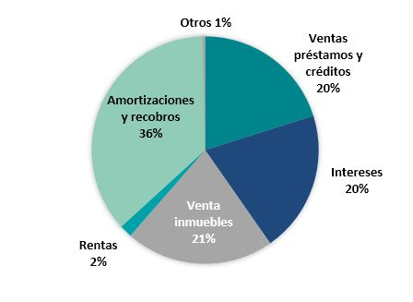
S.A.R.E.B’s ACTIVITY

Slide 11
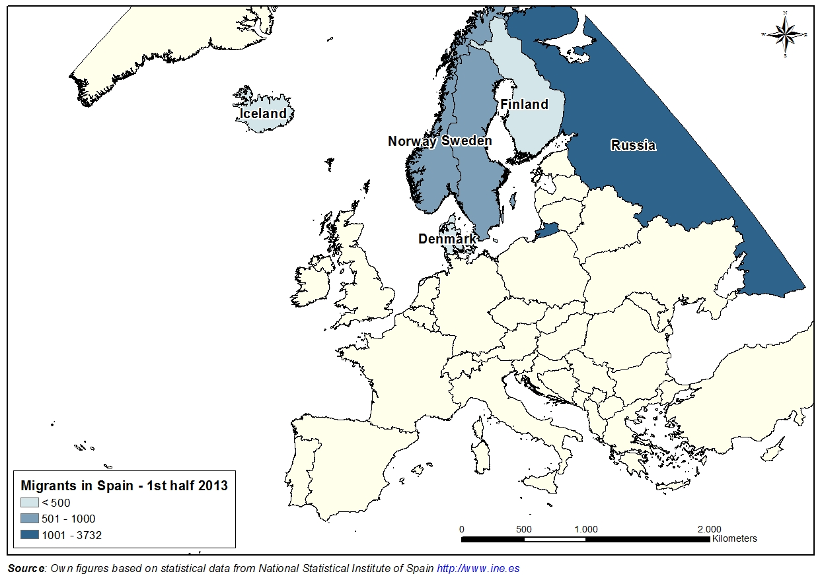

Slide 12
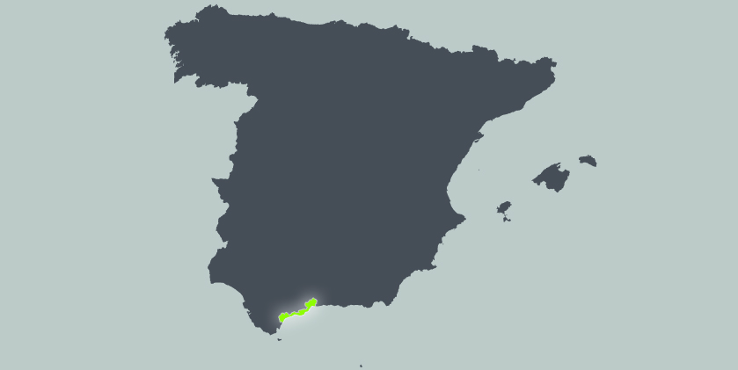

Slide 13
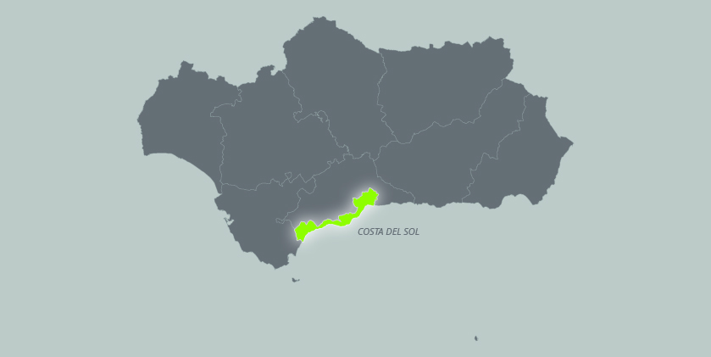

Slide 14
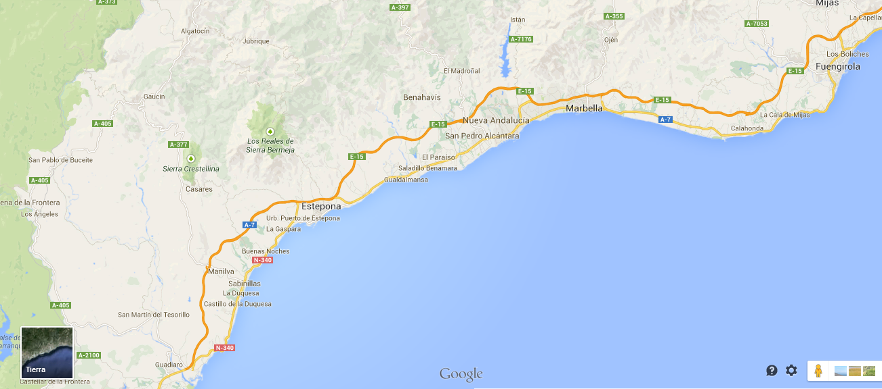

Slide 15
Iceland

Slide 16
STOCK OF UNSOLD HOUSES
Source: Ministerio Fomento, 2014

Slide 17
UNSOLD PROPERTY STOCK (SPAIN)
Source: CBRE, 2013

Slide 18
FOREIGN DEMAND
Source: CBRE, 2013

Slide 19
WHO IS BUYING?
The Scandinavian market has revitalized: Swedish, Danish, Norwegian and Finnish buyers. The Norwegian market, oil-based, has not experienced any kind of recession. Nordic economies strong, due primarily to the attractive, present South European property prices.
The Russian and Eastern European markets, more and more important.
The Netherlands and Belgium; strong markets because of the price drop.
The French market, the most recent important European market to discover Marbella. Why? recent change in government, increase in taxes, with many seeking to become Spanish residents to achieve a lower taxation level.
The United Kingdom and the German markets still remain among the most important markets in the Marbella area.
Chinese market, trying to get residency through new investment regulations, as well as far East countries. In Spain and Portugal, total investment of €500.000 guarantees residency.
Source: Newspaper SUR, March 2014

Slide 20
NEW HOUSING SOLD IN 2013
Spain: 145.241 properties sold (new houses).
Andalucía: 32.201 (new houses).
In Málaga 2013 (new houses): 9.526 properties sold; 4.640 bought by foreigners (50%).
In Málaga 2007 (new houses): 45.000 properties sold; 16.800 bought by foreigners (30%).
Property sales increased more in Marbella last year anywhere else in Spain.
Property transactions: Marbella: 3.115 in 2013, increasement of 23.6%; similar figure to pre-crisis results (2007).
37% increase of new houses sold in Andalucía.
Source: Newspaper SUR, March 2014

Slide 21
KEY DATA (2013)
Málaga, 2nd Spanish city in property investment by foreigners.
Average € invested: €157.000.
45% reduction of prices (Mediterranean coast).
9.5 million tourists in Costa del Sol.
50 million tourists in Spain.
WHO BOUGHT THEM?
British (1.000), Swedish (600), Belges (550), Norwegians (450),
Russians (450), French (440), Germans (280).
Source: Newspaper SUR, March 2014

Slide 22
WHAT’S SELLING?
Extremely active market.
Strong sales activity in the more expensive price ranges: Marbella’s prime residential areas, including Nueva Andalucía, Elviria, Monteros, Guadalmina, La Heredia, etc.
Important sign of a market under recovery: larger and more expensive properties have started to sell in the last year.
Wide variety of villas, townhouses and apartments in the €200.000 to €500.000 price range in great residential areas; highly competitive prices.
More villas for sale today under €1.000.000 than ever before, substantially reduced in price.
Source: Newspaper SUR, March 2014

Slide 23
Residential sales Marbella area increased in 2012 a significant 21.11% over 2011 sales.
Total number of villas and apartments sales per municipality | 2006 | 2007 | 2008 | 2009 | 2010 | 2011 | 2012
Benahavís | 650 | 633 | 438 | 559 | 422 | 311 | 592
Estepona | 1,788 | 2,581 | 1,721 | 1,086 | 1,154 | 1,248 | 1,501
Marbella | 4,432 | 3,568 | 2,110 | 2,199 | 2,389 | 2,259 | 2,531
TOTAL | 6,870 | 6,782 | 4,269 | 3,844 | 3,965 | 3,818 | 4,624
Source: Andalucía.com site, 2014

Slide 24
HOW DO SWEDISH NATIONALS INVEST ?
Between 2008-2011, Swedish buyers increased more than 138%.
Swedish investors search for a two bedrooms apartments with terrace. Budget around €180.000-€250.000.
Spanish Notarial Chamber’s records inform that average purchase price for Swedish in Spain in year 2010 was €252.766.
Until July 2012, Swedish nationals bought over 1.500 properties, being 2.971 properties in entire year 2011.
Source: Fastighetsbyrån, 2014

Slide 25
SCANDINAVIAN REAL STATES IN THE COSTA DEL SOL
Nordica Sales and Rental Team (Nueva Andalucía.
P. Rosen).
The Real Estate Agency (Fuengirola and Marbella).
Fastighetsbyrån (Fuengirola, Marbella, Nerja).
Marbella Estates (K. Hummelgren).
Andalucia Development (Marbella).

Slide 26
SCANDINAVIAN BANKS IN THE COSTA DEL SOL
Fastighetsbyrån Real Estate-Swedbank (Fuengirola/Marbella/Nerja).
Jiskebank (Fuengirola).
SparNord Bank.
Bergslagens Sparbank.
Handelsbanken (Marbella).
Nykredit.
Nordea Private Banking.

Slide 27
MORTGAGES IN SPAIN (Handelsbanken)
Source: Handelsbanken, 2014

Slide 28
Source: Handelsbanken, 2014

Slide 29
OTHER REASONS TO INVEST IN SPANISH PROPERTY MARKET
Currency exchange 1€=8/9 SEK.
Wide variety of property stock.
Nordic and Spanish banks open to new investors.
Nordic colony settled Málaga’s coast.
Cultural, social, living reasons.
Golf + beach…

Slide 30
GOLF COURSES IN THE AREA

Slide 31
NEARLY A HUNDRED GOLF COURSES IN THE AREA

Slide 33
NUEVA ANDALUCÍA 189.000€

Slide 34
Nueva Andalucía, a short walk from Puerto Banus 240.000€

Slide 35
Los Naranjos de Marbella. 260.000€

Slide 36
Albatross Hills, top of the Golf Valley

Slide 37
Apartment Duplex in Benahavis

Slide 38
Benahavis. "La Heredia", foothills of Ronda mountains

Slide 39
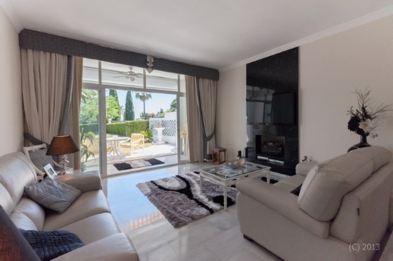
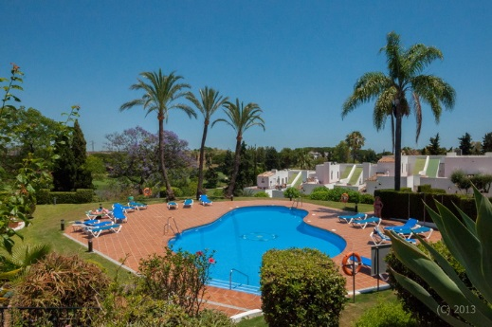
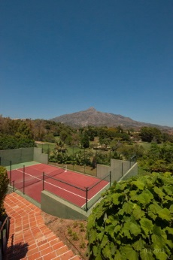
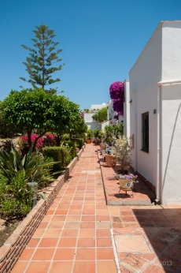
Aloha Townhouse €235.000

Slide 40
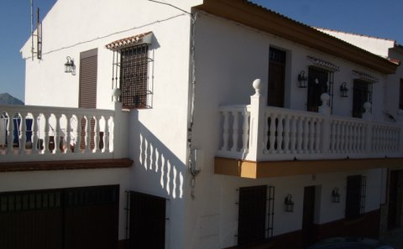
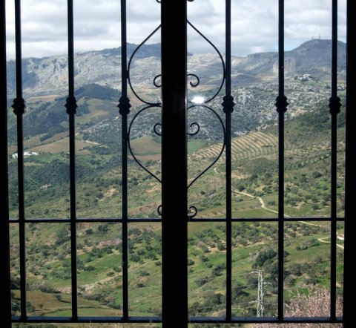
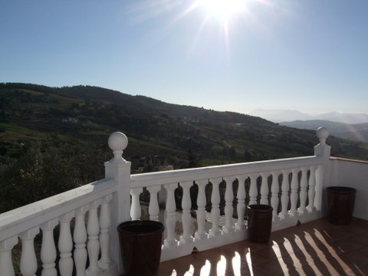
ANTEQUERA Puerto del Barco

Slide 41
Calahonda

Slide 42
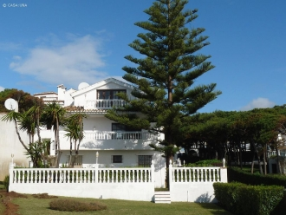
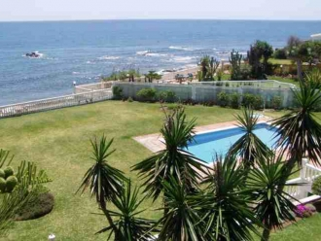
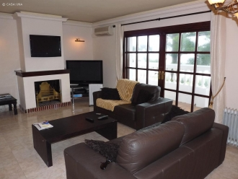
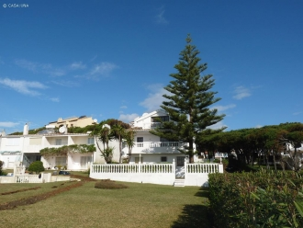
Calahonda

Slide 43
Hacienda las Chapas Marbella

Slide 44
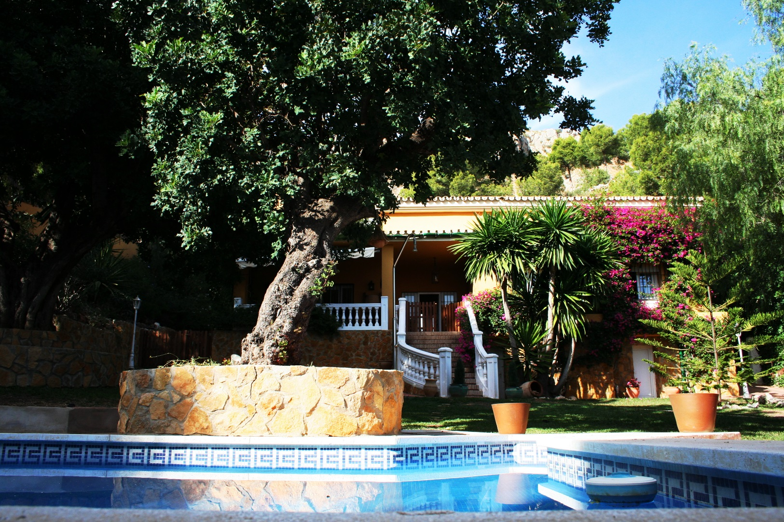
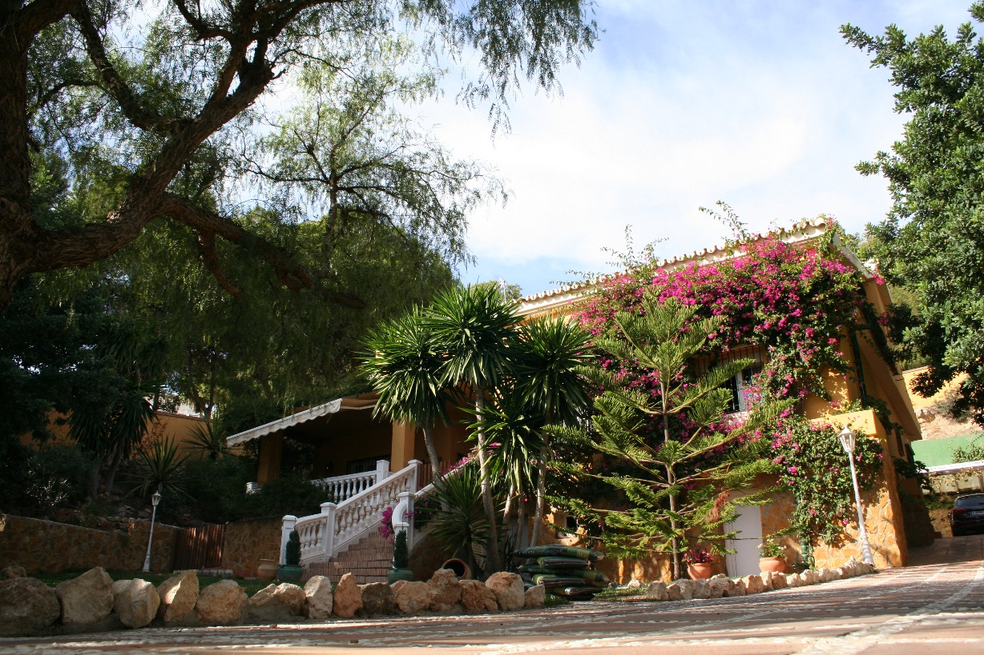
Los Randos, Málaga

Slide 45
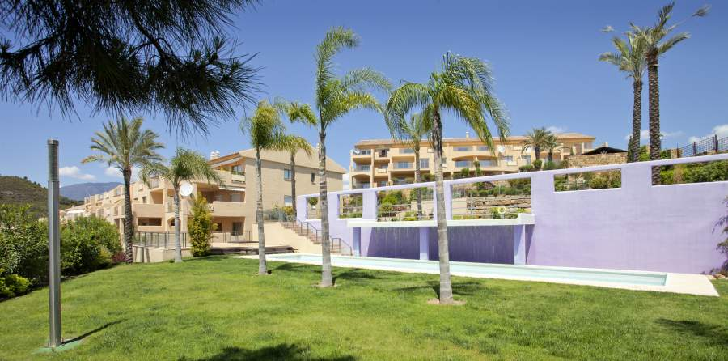
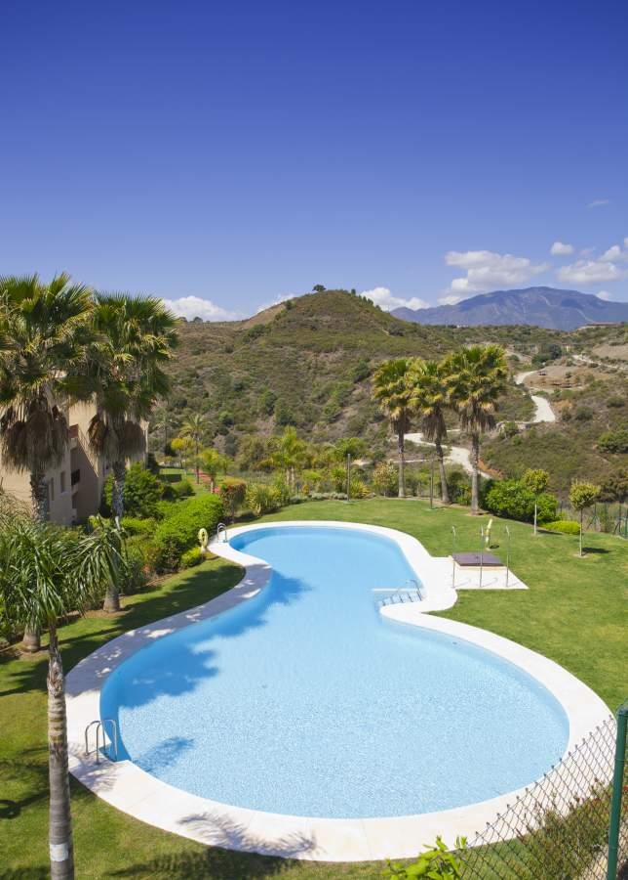
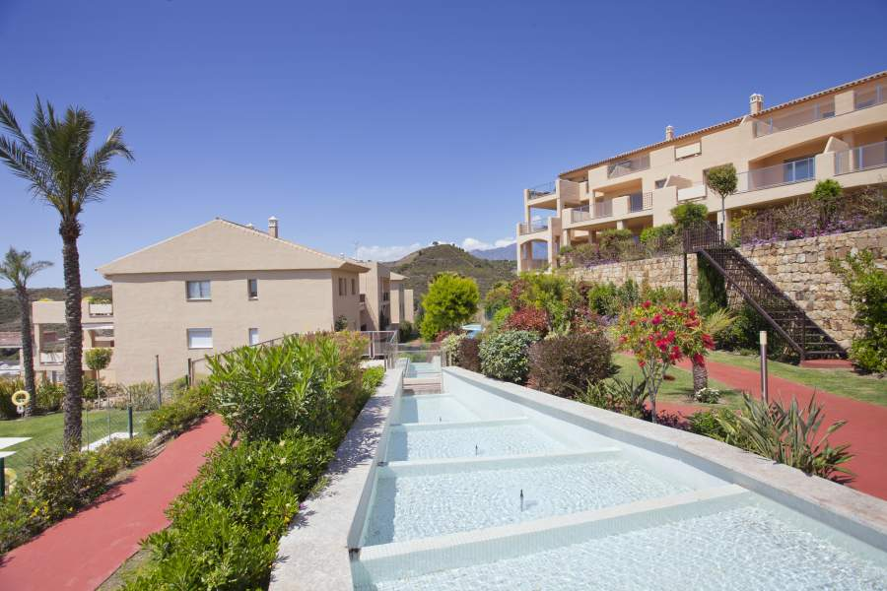
Estepona

Slide 46
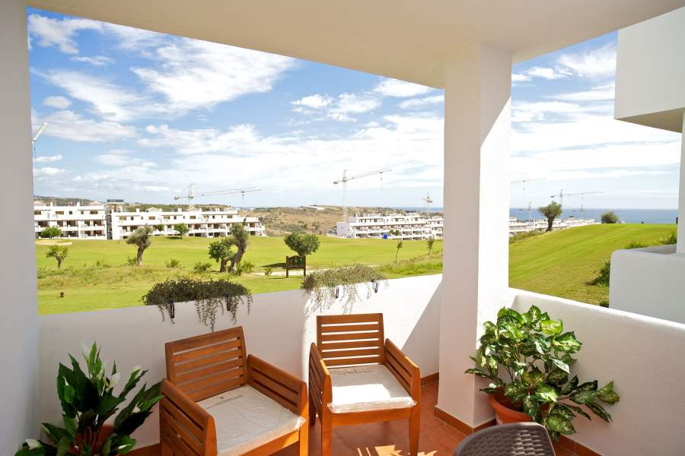
Estepona Golf

Slide 47
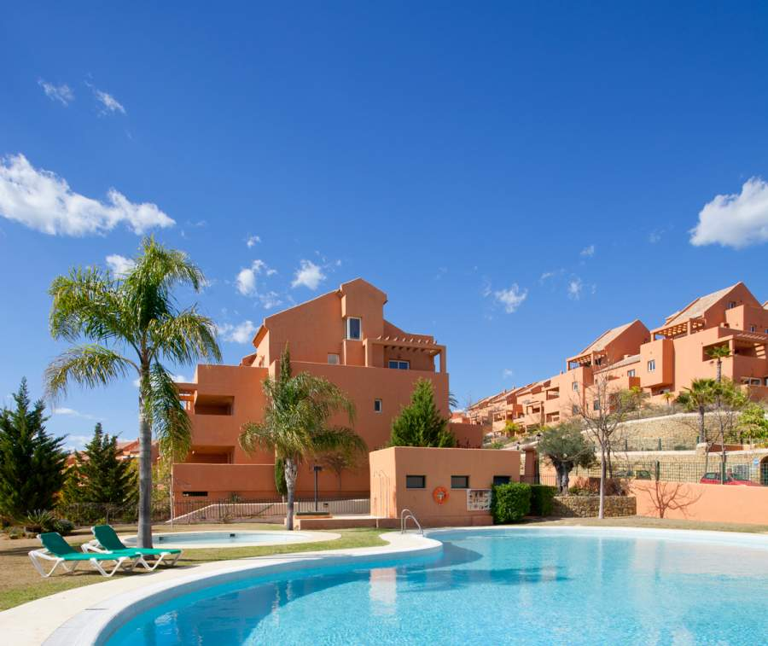
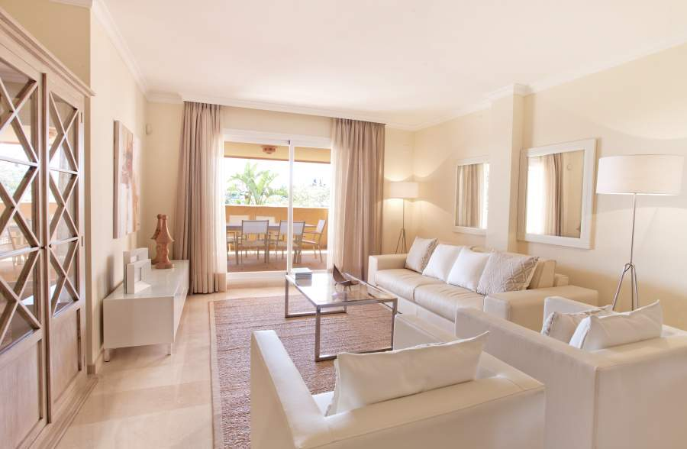
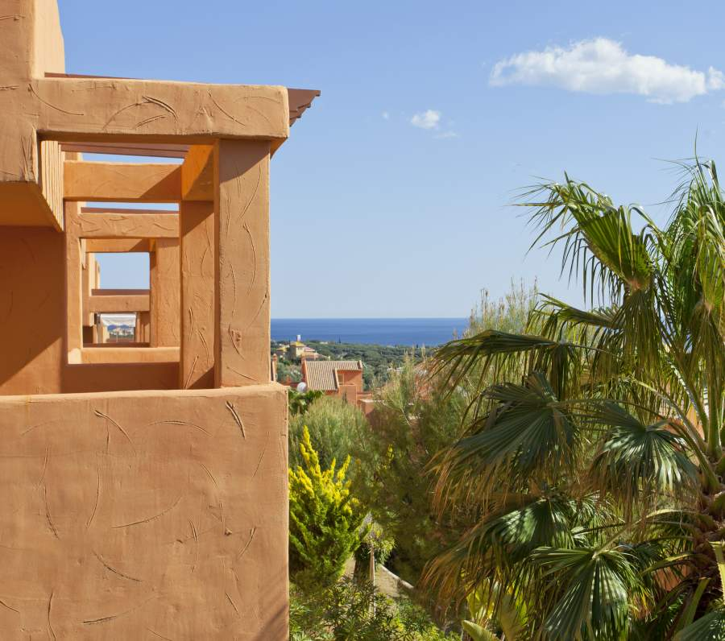
Los Lagos, Marbella

Slide 48
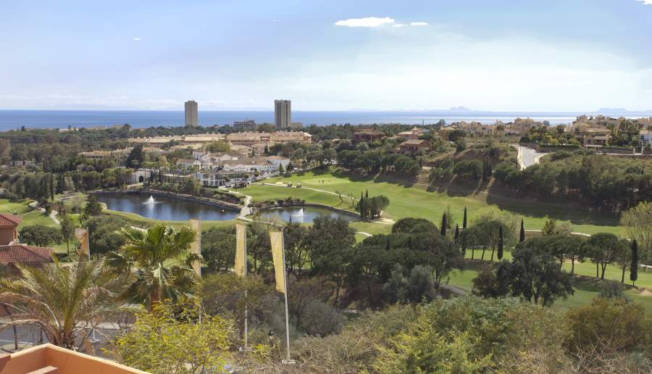
Los Lagos, Marbella

Slide 49
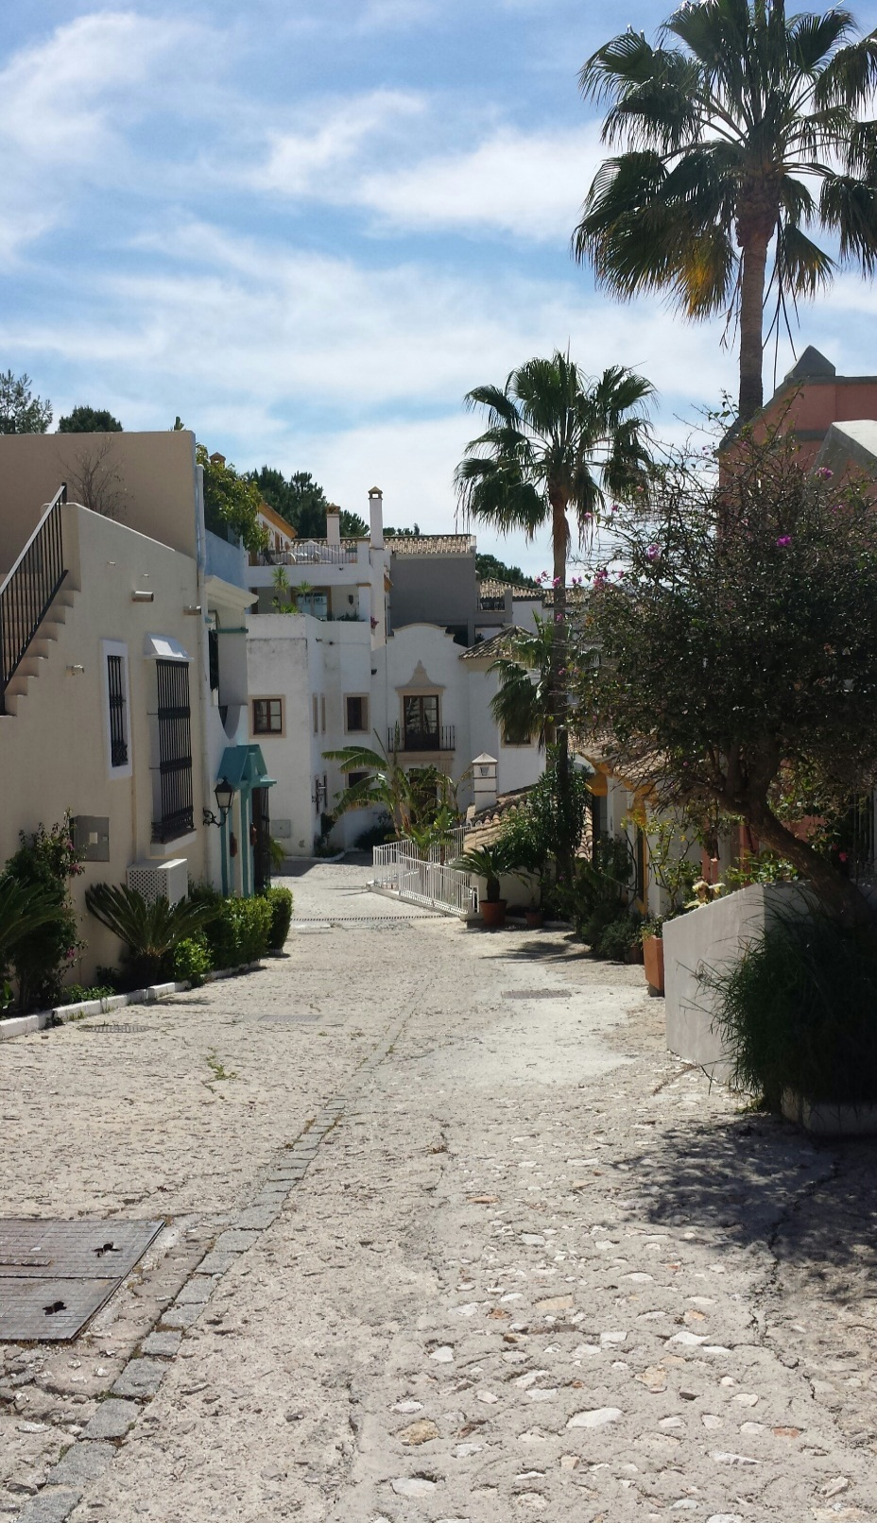
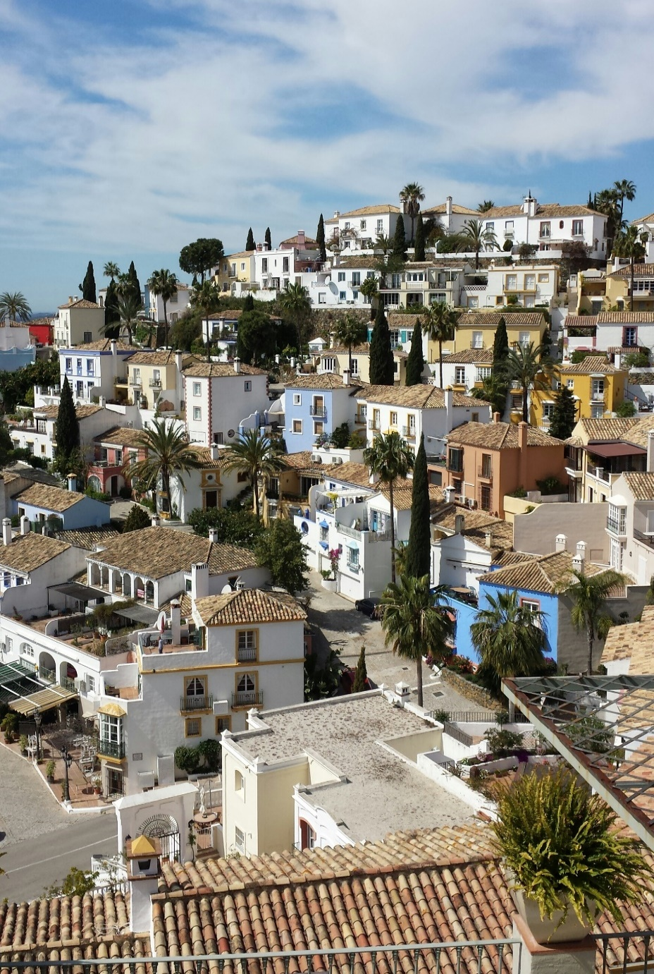
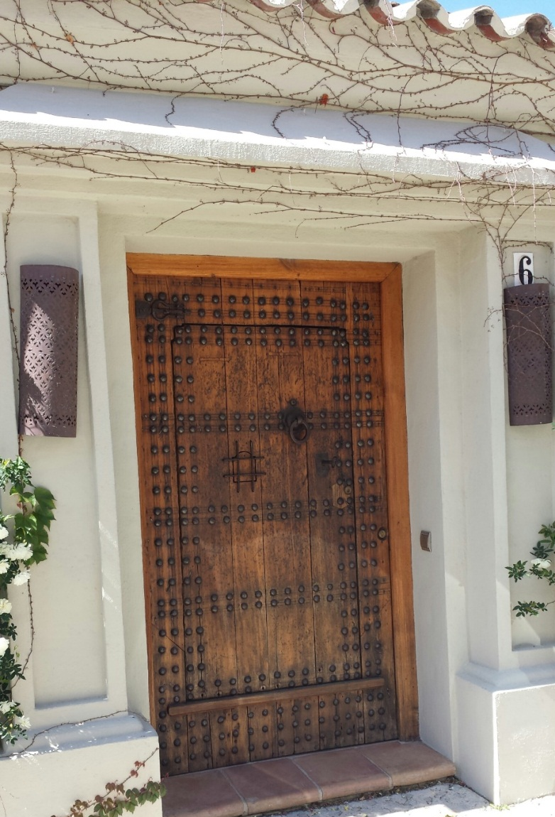
La Heredia. Benahavís

Slide 50
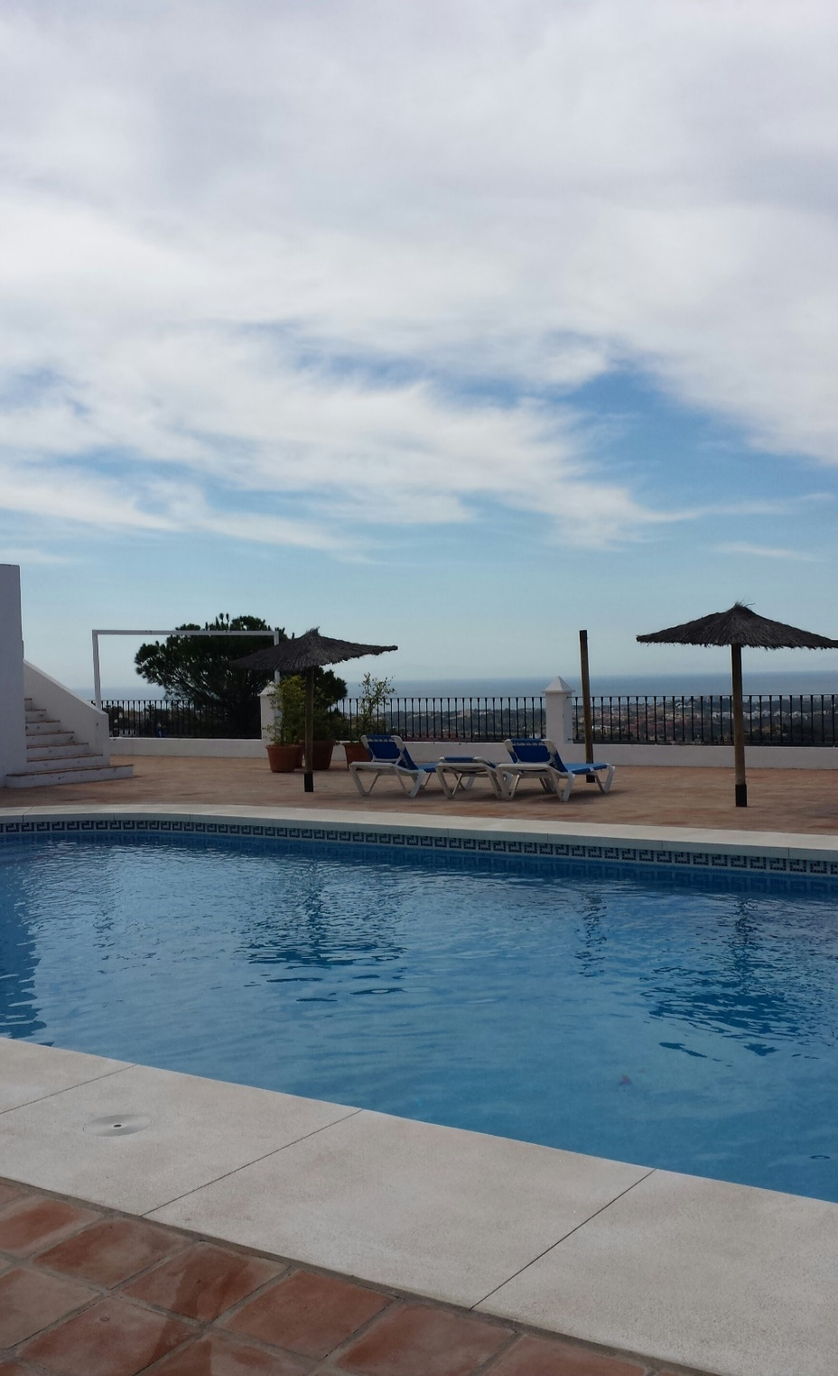
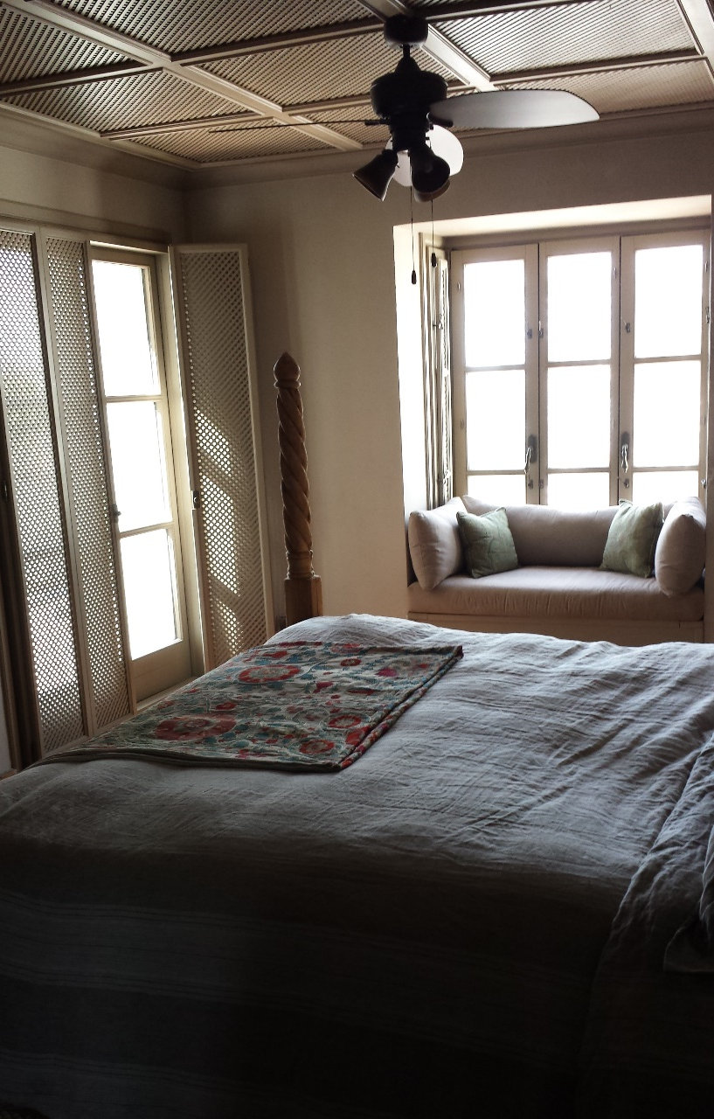
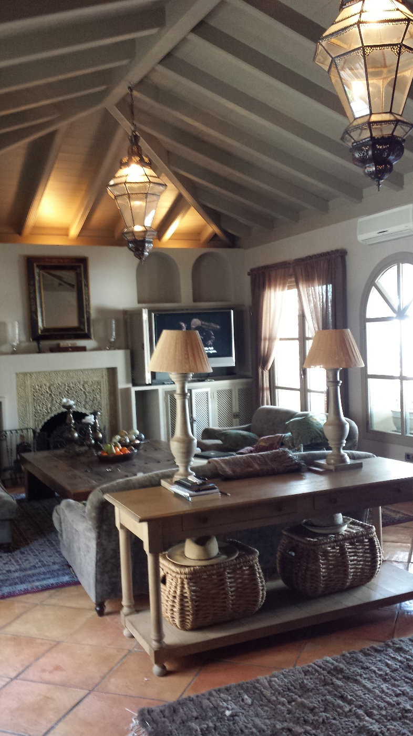
La Heredia. Benahavís

Slide 51
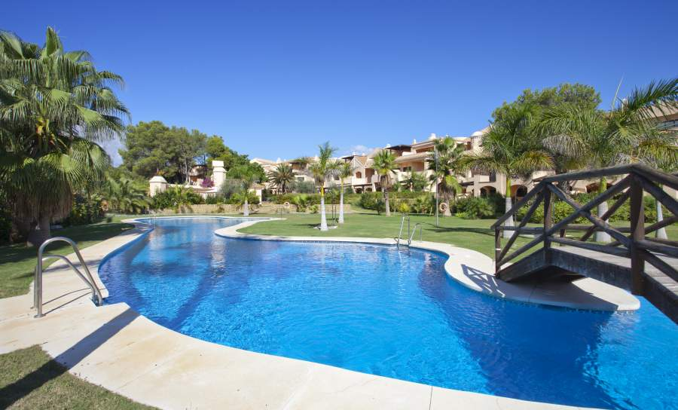
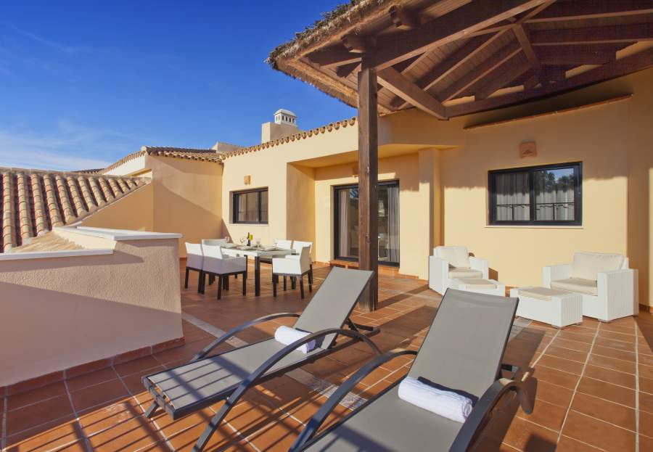
Marbella, 500.000€

Slide 52
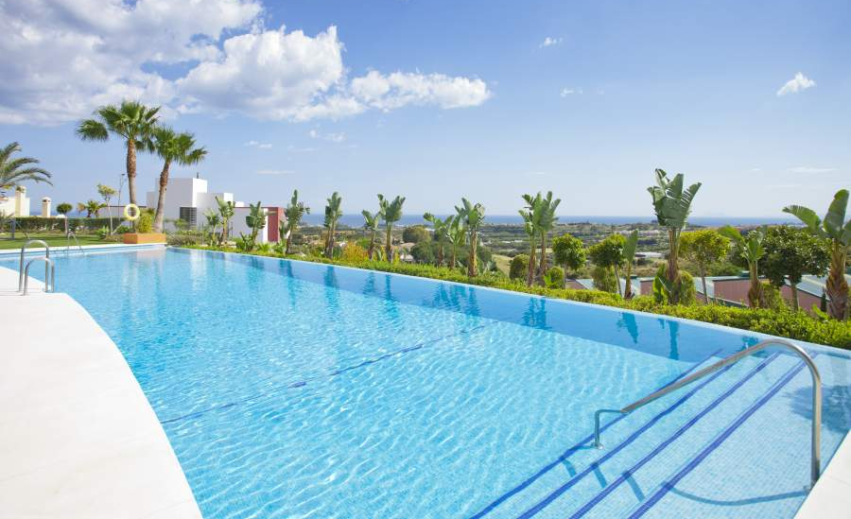
Marbella, Los Flamingos

Slide 53
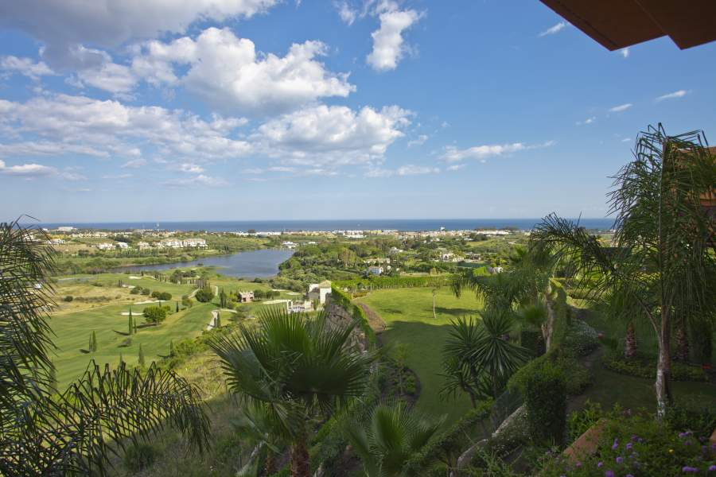
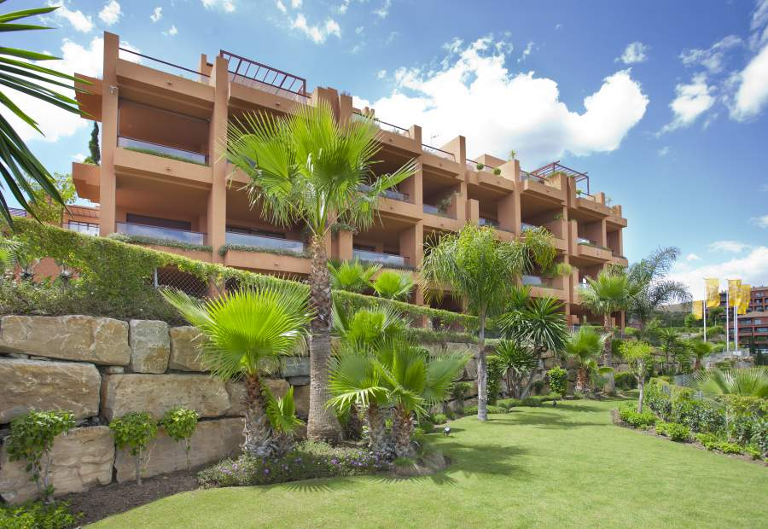
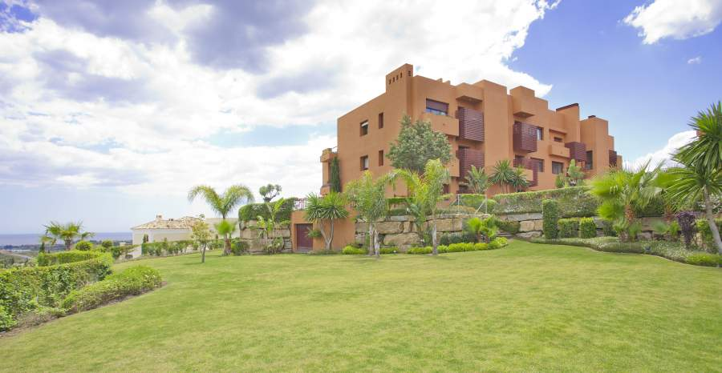
Marbella.
Los Flamingos

Slide 54
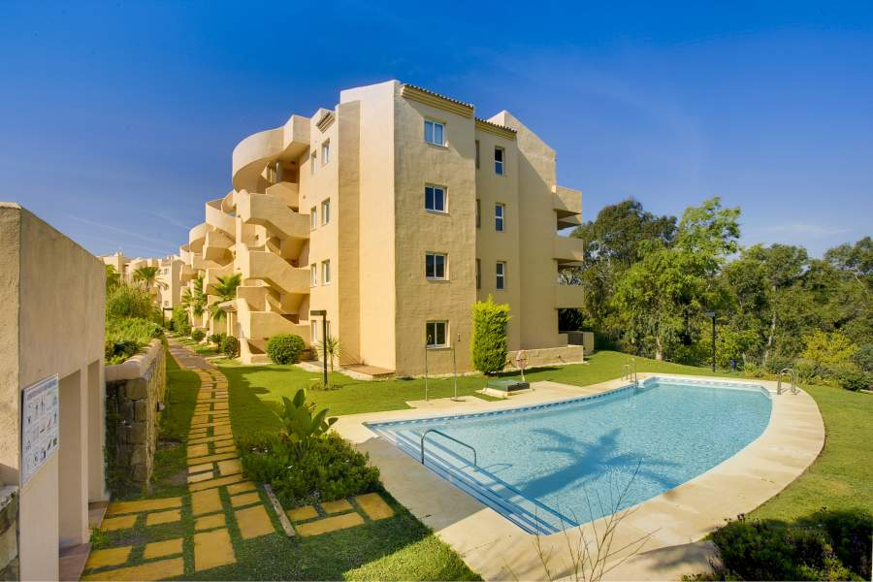
Marbella. Green Hills

Slide 55
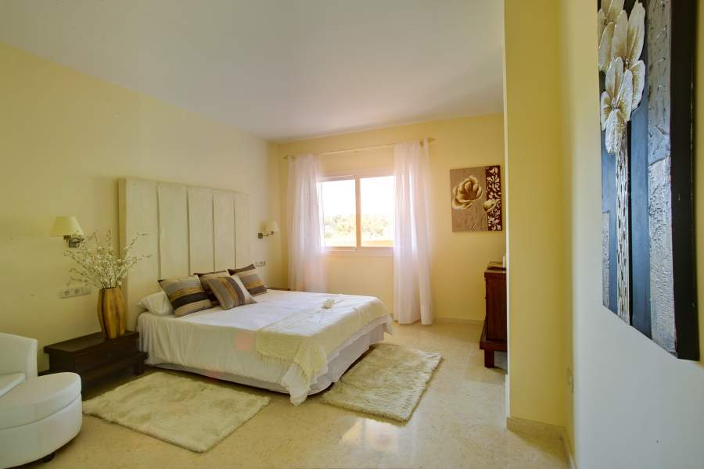
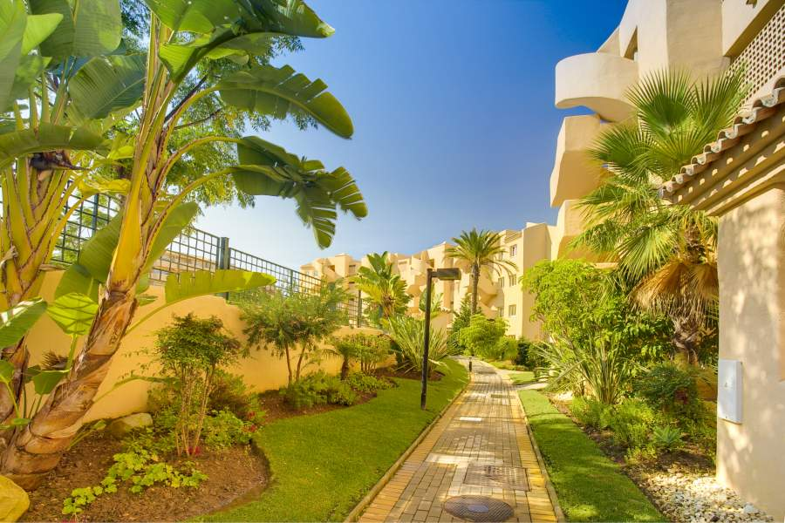
Marbella.Green Hills

Slide 56
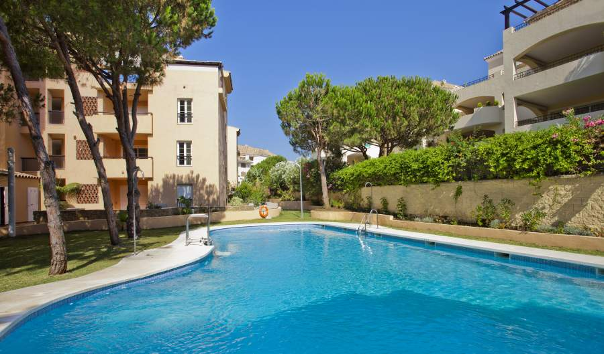
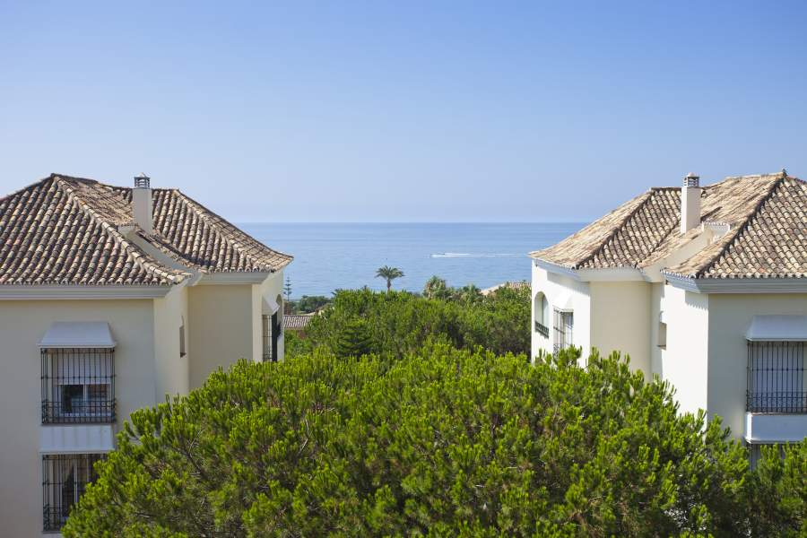
Elviria. Marbella

Slide 57
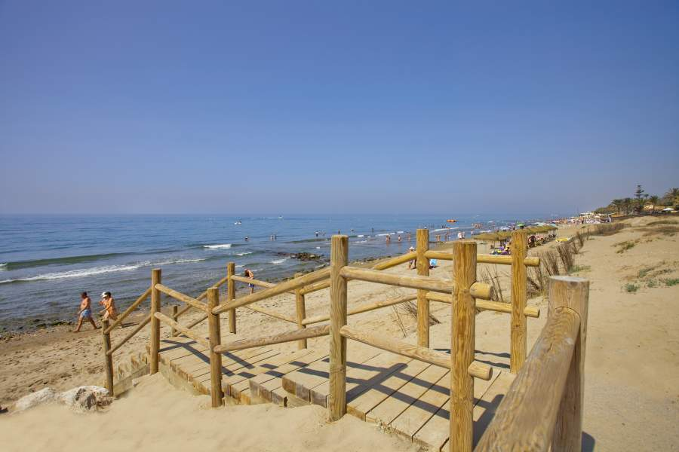
Elviria. Marbella

Slide 58
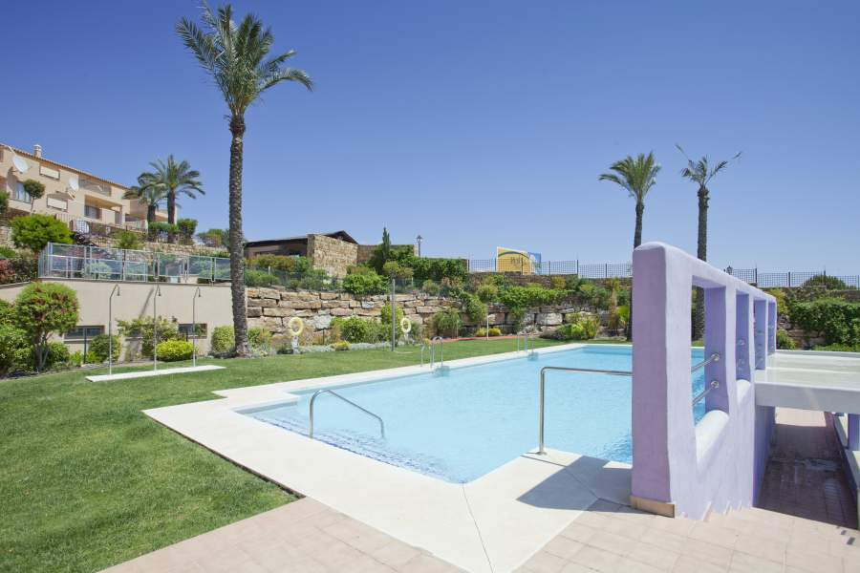
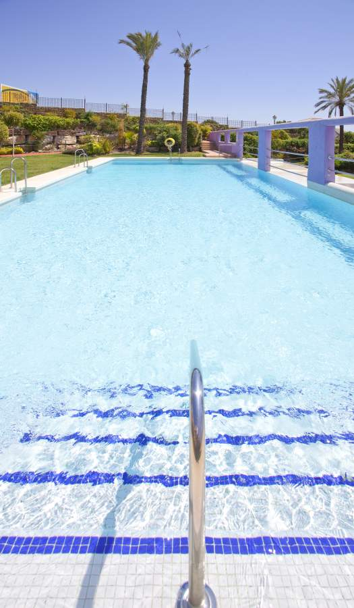
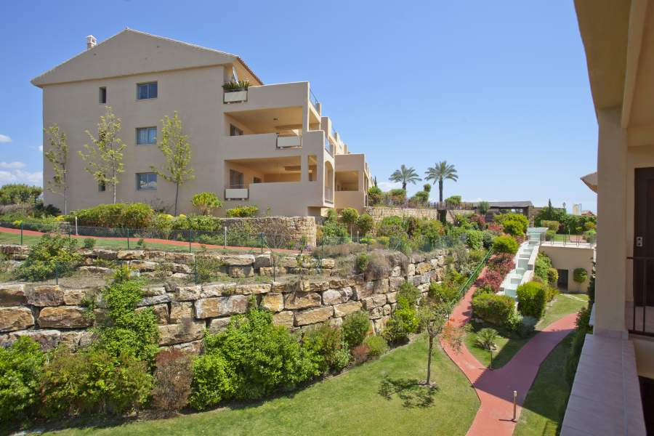
Estepona

Slide 59
Estepona

